Slide 1

Process Synchronization
Lecture #11

Slide 2
Process Synchronization
Process Synchronization means sharing system resources by processes in a such a way that, Concurrent access to shared data is handled thereby minimizing the chance of inconsistent data.
Maintaining data consistency demands mechanisms to ensure synchronized execution of cooperating processes.
Process Synchronization was introduced to handle problems that arose while multiple process executions.

Slide 3
Producer Consumer Problem
The producer consumer problem is a synchronization problem.
There is a fixed size buffer and the producer produces items and enters them into the buffer.
The consumer removes the items from the buffer and consumes them.
A producer should not produce items into the buffer when the consumer is consuming an item from the buffer and vice versa.
So the buffer should only be accessed by the producer or consumer at a time.
Video: https://www.youtube.com/watch?v=iMD1Z3f9ioI&list=PLxCzCOWd7aiGz9donHRrE9I3Mwn6XdP8p&index=27

Slide 4
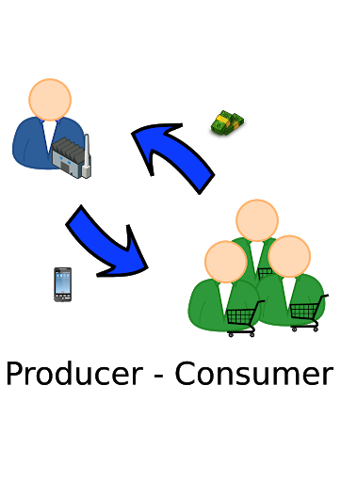
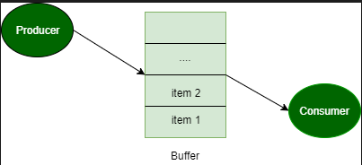
Producer Consumer Problem

Slide 5
Cont..
One solution to the producer-consumer problem uses shared memory.
To allow producer and consumer processes to run concurrently, we must have available a buffer of items that can be filled by the producer and emptied by the consumer.
This buffer will reside in a region of memory that is shared by the producer and consumer processes.

Slide 6
Cont...
This buffer will reside in a region of memory that is shared by the producer and consumer processes.
A producer can produce one item while the consumer is consuming another item.
The producer and consumer must be synchronized, so that the consumer does not try to consume an item that has not yet been produced.

Slide 7
Cont..
Two types of buffers can be used.
The unbounded buffer places no practical limit on the size of the buffer. The consumer may have to wait for new items, but the producer can always produce new items.
The bounded buffer assumes a fixed buffer size. In this case, the consumer must wait if the buffer is empty, and the producer must wait if the buffer is full.

Slide 8
Process Synchronization
Suppose that we wanted to provide a solution to the consumer-producer problem that fills all the buffers.
We can do so by having an integer count that keeps track of the number of full buffers.
Initially, count is set to 0.
It is incremented by the producer after it produces a new buffer and is decremented by the consumer after it consumes a buffer.

Slide 9
Proposed solutions to the Single Producer-Consumer Problem
Assume a scenario with identical characteristics as those which form the basic Producer-Consumer problem, i.e. two processes, one Producer, one Consumer and a shared data area.
Furthermore, assume that the code executed by the Producer and the Consumer follows the same pattern as outlined below…

Slide 10
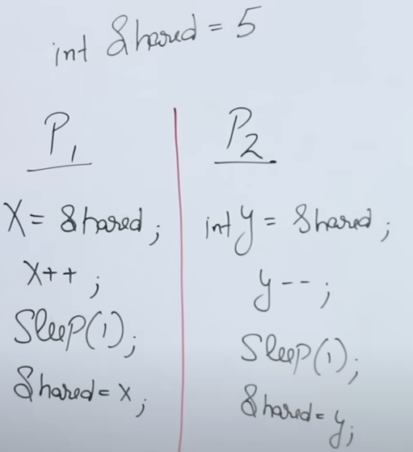
Race Condition

Slide 11
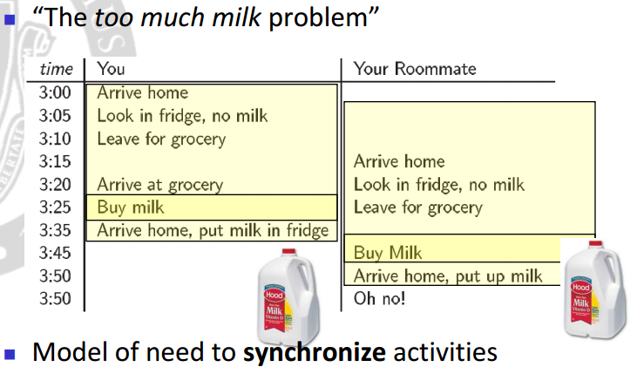
Race Condition

Slide 12
Race Condition
“A situation, where several processes access and manipulate the same data concurrently and the outcome of the execution depends on the particular order in which the access takes place, is called a race condition.”

Slide 13
Critical Section Problem
A Critical Section is a code segment that accesses shared variables and has to be executed as an atomic action.
It means that in a group of cooperating processes, at a given point of time, only one process must be executing its critical section.
If any other process also wants to execute its critical section, it must wait until the first one finishes.

Slide 14
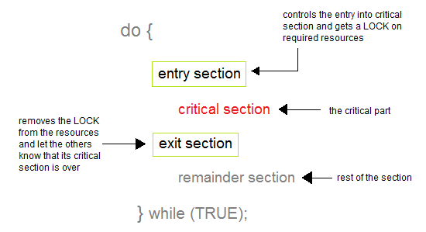
Critical Section Problem

Slide 15
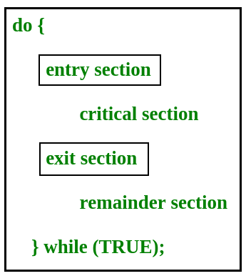
Cont.

Slide 16
Cont.
Any solution to the critical section problem must satisfy three requirements:
Mutual Exclusion
Progress
Bounded Waiting

Slide 17
Cont.
1. Mutual Exclusion - If process Pi is executing in its critical section, then no other processes can be executing in their critical sections
2. Progress - If no process is executing in its critical section and there exist some processes that wish to enter their critical section, then the selection of the processes that will enter the critical section next cannot be postponed indefinitely
3. Bounded Waiting - A bound must exist on the number of times that other processes are allowed to enter their critical sections after a process has made a request to enter its critical section and before that request is granted
Assume that each process executes at a nonzero speed
No assumption concerning relative speed of the n processes

Slide 18
Peterson’s Solution
Peterson's solution is restricted to two processes that alternate execution between their critical sections and remainder sections.
Assume that the LOAD and STORE instructions are atomic; that is, cannot be interrupted.

Slide 19
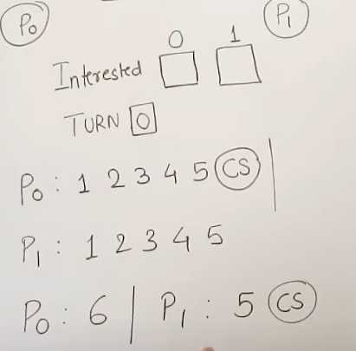
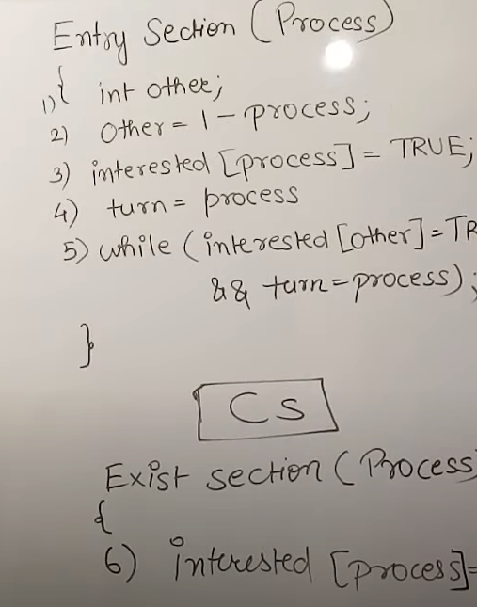
Conti.
Video: https://www.youtube.com/watch?v=7_h04U_VU5w

Slide 20
Question?

